Slide 1
Likelihood & Hierarchical Models
θ_{ij} ∼ Ν(ψ_{j},ω_{j}²)
ψ_{j} ∼ Ν(μ,τ²)

Slide 2
This is an approximation…
Biased if n is small in many studies
Biased if distribution of effect sizes isn't normal
Biased for some estimators of w_{i}

Slide 3
Solution: estimate t² from the data using Likelihood

Slide 4
Likelihood: how well data support a given hypothesis.
Note: Each and every parameter choice IS a hypothesis

Slide 5
L(θ|D) = p(D|θ)
Where D is the data and θ is some choice of parameter values

Slide 6
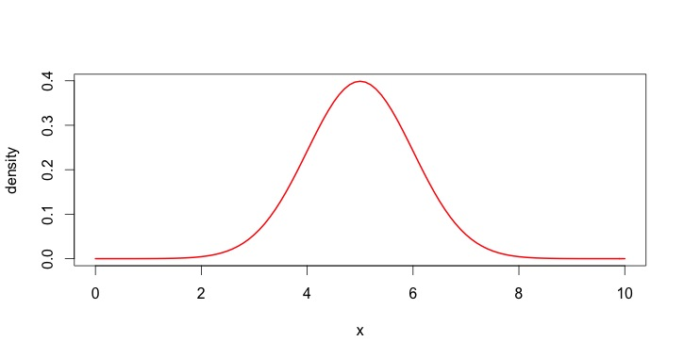
Calculating a Likelihood
μ = 5, σ = 1

Slide 7
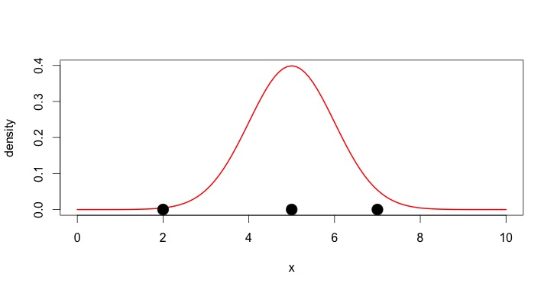
Calculating a Likelihood
μ = 5, σ = 1

Slide 8
Calculating a Likelihood
μ = 5, σ = 1

Slide 9
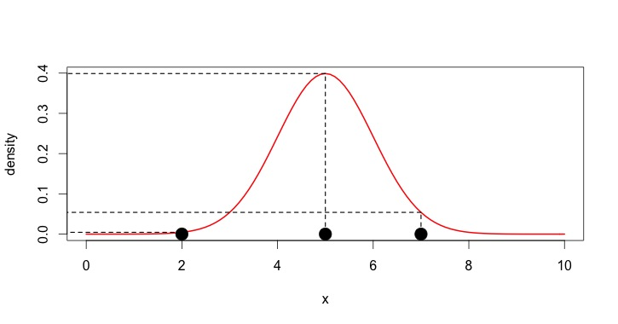
Calculating a Likelihood
μ = 5, σ = 1
L(μ=5|D) = p(D|μ=5) = y1*y2*y3
y1
y2
y3

Slide 10
The Maximum Likelihood Estimate is the value at which p(D|θ) is highest.

Slide 11
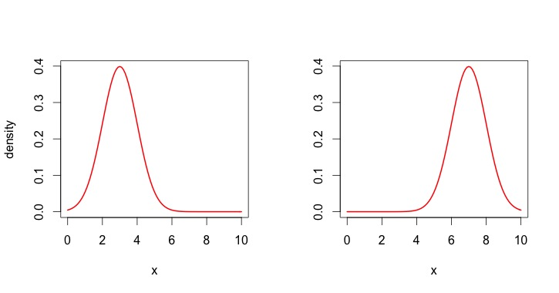
Calculating Two Likelihoods
μ = 3, σ = 1
μ = 7, σ = 1

Slide 12
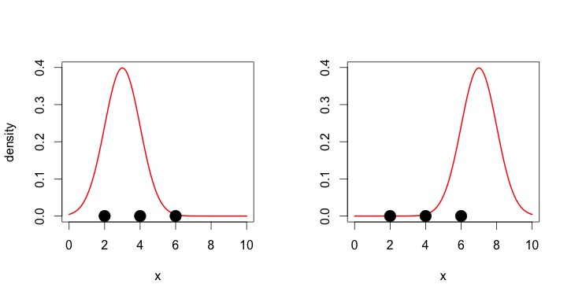
Calculating Two Likelihoods
μ = 3, σ = 1
μ = 7, σ = 1

Slide 13
Calculating Two Likelihoods
μ = 3, σ = 1
μ = 7, σ = 1

Slide 14
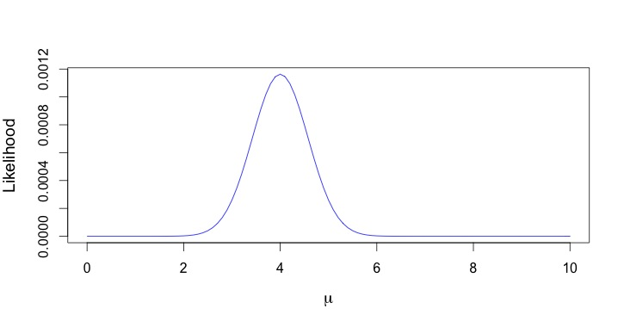
Maximum Likelihood

Slide 15
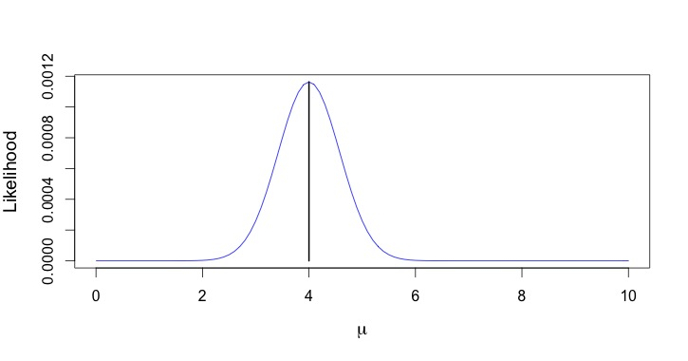
Maximum Likelihood

Slide 16
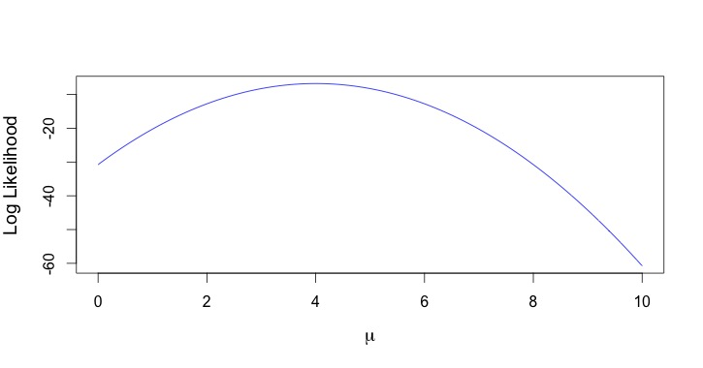
Log-Likelihood

Slide 17
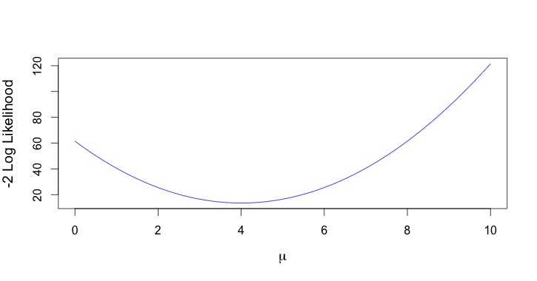
-2*Log-Likelihood = Deviance
Ratio of deviances of nested models is ~ χ² Distributed,
so, we can use it for tests!

Slide 18
Last Bits of Likelihood Review
θcan be as many parameters for as complex a model as we would like
Underlying likelihood equation also encompasses distributional information
Multiple algorithms for searching parameter space

Slide 19
rma(Hedges.D, Var.D, data=lep, method="ML")
Random-Effects Model (k = 25; tau^2 estimator: DL)
tau^2 (estimated amount of total heterogeneity): 0.0484 (SE = 0.0313)
tau (square root of estimated tau^2 value): 0.2200
I^2 (total heterogeneity / total variability): 47.47%
H^2 (total variability / sampling variability): 1.90
Test for Heterogeneity:
Q(df = 24) = 45.6850, p-val = 0.0048
Model Results:
estimate se zval pval ci.lb ci.ub
0.3433 0.0680 5.0459 <.0001 0.2100 0.4767

Slide 20
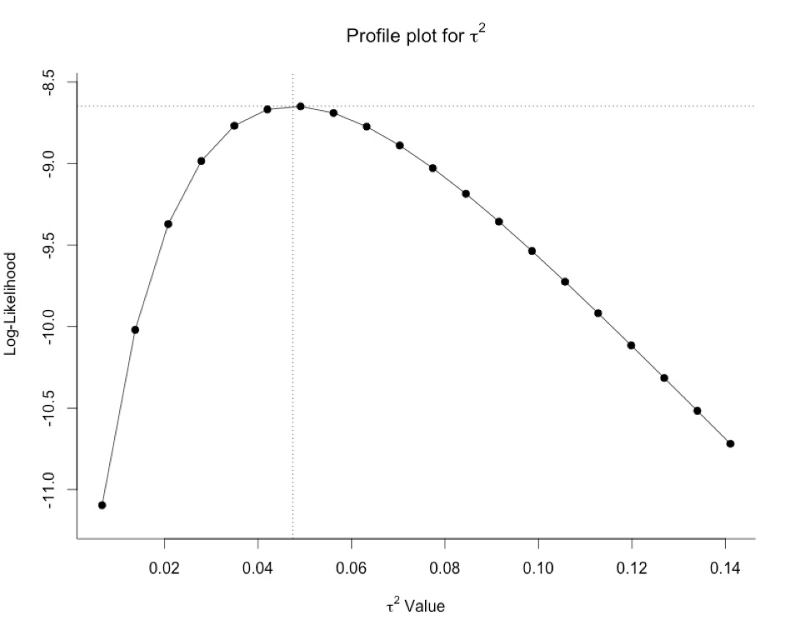
profile(gm_mod_ML)

Slide 21
REML v. ML
In practice we use Restricted Maximum Likelihood (REML)
ML can produce biased estimates if multiple variance parameters are unknown
In practice, σ²_{i} from our studies is an observation. We must estimate σ²_{i} as well as τ²

Slide 22
The REML Algorithm in a Nutshell
Set all parameters as constant, except one
Get the ML estimate for that parameter
Plug that in
Free up and estimate the next parameter
Plug that in
Etc...
Revisit the first parameter with the new values, and rinse and repeat

Slide 23
OK, so, we should use ML for random/mixed models – is that it?

Slide 24
Meta-Analytic Models so far
Fixed Effects: 1 grand mean
Can be modified by grouping, covariates
Random Effects: Distribution around grand mean
Can be modified by grouping, covariates
Mixed Models:
Both predictors and random intercepts

Slide 25
What About This Data?
Study | Experiment in Study | Hedges D | V Hedges D
Ramos & Pinto 2010 | 1 | 4.32 | 7.23
Ramos & Pinto 2010 | 2 | 2.34 | 6.24
Ramos & Pinto 2010 | 3 | 3.89 | 5.54
Ellner & Vadas 2003 | 1 | -0.54 | 2.66
Ellner & Vadas 2003 | 2 | -4.54 | 8.34
Moria & Melian 2008 | 1 | 3.44 | 9.23

Slide 26
Hierarchical Models
Study-level random effect
Study-level variation in coefficients
Covariates at experiment and study level

Slide 27
Hierarchical Models
Random variation within study (j) and between studies (i)
T_{ij} ∼ Ν(θ_{ij}, σ_{ij}²)
θ_{ij} ∼ Ν(ψ_{j},ω_{j}²)
ψ_{j} ∼ Ν(μ,τ²)

Slide 28
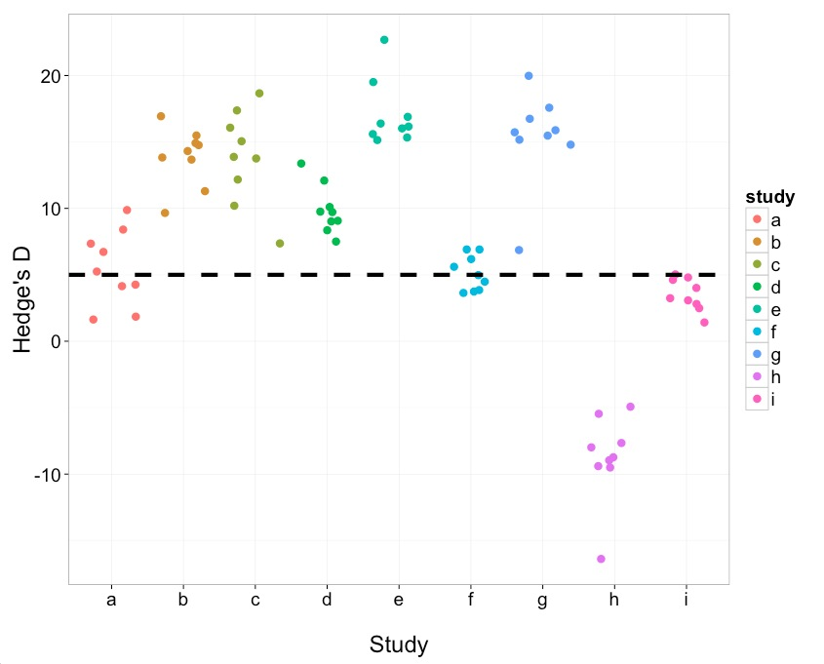
Study Level Clustering

Slide 29
Hierarchical Partitioning of One Study
Study Mean
Variation due to ω
Variation due to τ
Grand Mean

Slide 30
Hierarchical Models in Paractice
Different methods of estimation
We can begin to account for complex non-independence
But for now, we'll start simple…

Slide 32
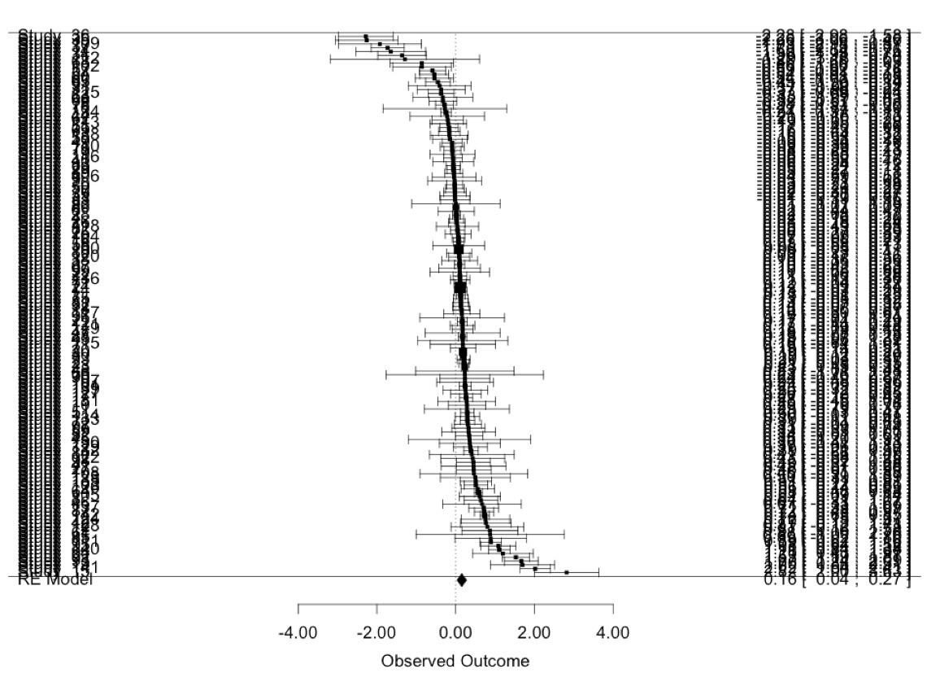

Slide 33
Linear Mixed Effects Model
> marine_lme <- lme(LR ~ 1,
random=~1|Study/Entry,
data=marine,
weights=varFunc(~VLR))

Slide 34
summary(marine_lme)
...
Random effects:
Formula: ~1 | Study
(Intercept)
StdDev: 0.2549197
Formula: ~1 | Entry %in% Study
(Intercept) Residual
StdDev: 0.02565482 2.172048
...
τ
ω

Slide 35
summary(marine_lme)
...
Variance function:
Structure: fixed weights
Formula: ~VLR
Fixed effects: LR ~ 1
Value Std.Error DF t-value p-value
(Intercept) 0.1807378 0.05519541 106 3.274508 0.0014
...

Slide 36
Meta-Analytic Version
> marine_mv <- rma.mv(LR ~ 1, VLR,
data=marine,
random= list(~1|Study,
~1|Entry))
Allows greater flexibility in variance structure and correlation, but, some under-the-hood differences

Slide 37
summary(marine_mv)
Multivariate Meta-Analysis Model (k = 142; method: REML)
logLik Deviance AIC BIC AICc
-126.8133 253.6265 259.6265 268.4728 259.8017
Variance Components:
estim sqrt nlvls fixed factor
sigma^2.1 0.1731 0.4160 142 no Entry
sigma^2.2 0.0743 0.2725 36 no Study
ω²
τ²

Slide 38
summary(marine_mv)
Test for Heterogeneity:
Q(df = 141) = 1102.7360, p-val < .0001
Model Results:
estimate se zval pval ci.lb ci.ub
0.1557 0.0604 2.5790 0.0099 0.0374 0.2741 **
---
Signif. codes: 0 ‘***’ 0.001 ‘**’ 0.01 ‘*’ 0.05 ‘.’ 0.1 ‘ ’ 1

Slide 39
Comparison of lme and rma.mv
 | τ² | ω²
rma.mv | 0.074 | 0.173
lme | 0.065 | 0.026
lme and rma.mv use different weighting
rma.mv assumes variance is known
lme assumes you know proportional differences in variance
http://www.metafor-project.org/doku.php/tips:rma_vs_lm_and_lme

