Slide 1
Meta-Regression & Mixed Effects
T_{i} ~ N(θ_{i},σ_{i}²)
θ_{i} ~ N(μ,τ²)

Slide 2
There’s a Grand Mean. Everything else is noise.

Slide 3
A First Stab at a Model: Fixed Effects
Starting model: there is only one grand mean, everything else is error
T_{i} ∼ Ν(θ_{i,} σ_{i}²)
where
θ_{i} = μ

Slide 4
Assessing Heterogeneity
Q_{t} follows a χ2 distribution with K-1 DF
Test for Heterogeneity:
Q(df = 24) = 45.6850, p-val = 0.0048

Slide 5
Solutions to Heterogeneity
Heterogeneity
Allow Variation in θ
Random Effects Model
Model Drivers of Heterogeneity (Fixed)
Model Drivers &
Allow Variation in θ
Mixed Effects Model

Slide 6
There is a Grand Mean Study Means are from a distribution Also, there’s additional error…

Slide 7
The Random Effects Model
Each study's mean is drawn from a distribution, everything else is error
T_{i} ∼ Ν(θ_{i}, σ_{i}²)
θ_{i} ∼ Ν(μ,τ²)

Slide 8
Adding group structure to a Fixed Effects Model

Slide 9
A Fixed Effect Group Model
Starting model: there are group means, everything else is error
T_{i} ∼ Ν(θ_{im,} σ_{i}²)
where
θ_{im} = μ_{m}

Slide 10
So…Does Group Structure Matter?
Qt = Qm + Qe
We can now partition total variation into that driven by the model versus residual heterogeneity
Kinda like ANOVA, no?

Slide 11
Solutions to Heterogeneity
Heterogeneity
Allow Variation in θ
Random Effects Model
Model Drivers of Heterogeneity (Fixed)
Model Drivers &
Allow Variation in θ
Mixed Effects Model

Slide 12
A Mixed Effect Group Model
Group means, random study effect, and then everything else is error
T_{i} ∼ Ν(θ_{im,} σ_{i}²)
where
θ_{im} ∼ Ν(μ_{m},τ²)

Slide 13
Simple Random Effects τ²
Q_{t}, w_{i}, etc. are all from the fixed model
This formula varies with model structure

Slide 14
Mixed Model with Groups τ²
Q_{t}, w_{i}, etc. are all from the fixed model
n=total # of studies
M=total # of groups

Slide 15
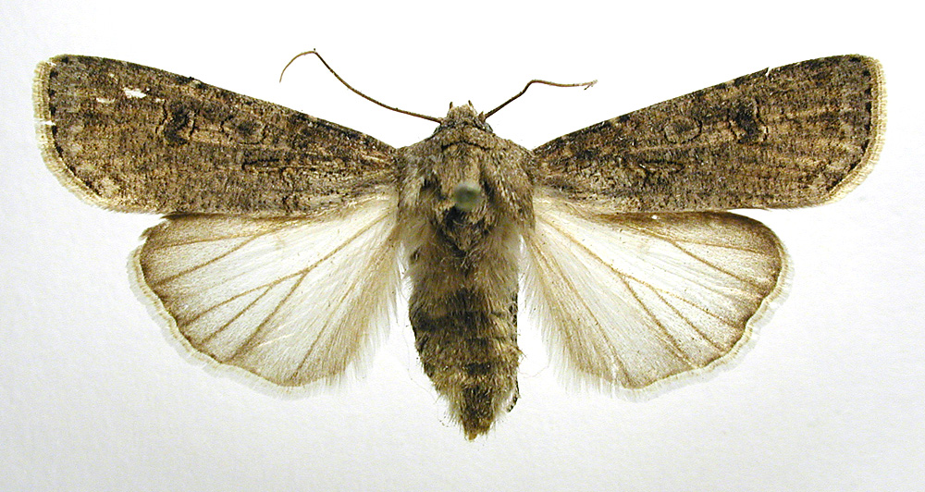
Our Question!
Male mating history and female fecundity in the Lepidoptera: do male virgins make better partners?
Agrotis segetum - wikipedia
Torres-Villa and Jennions 2005

Slide 16
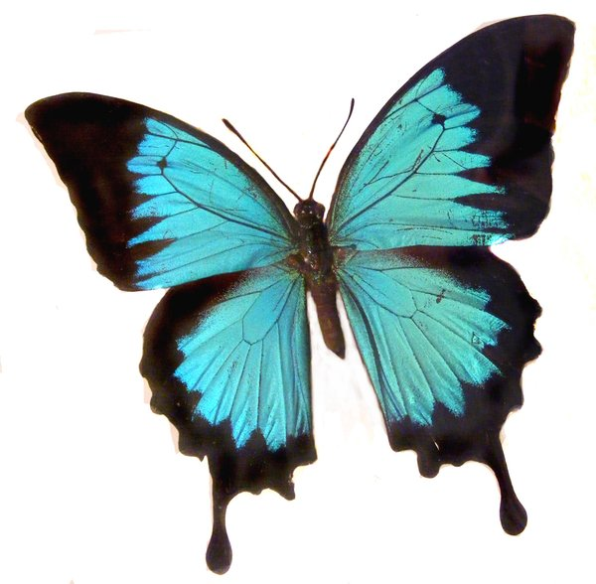
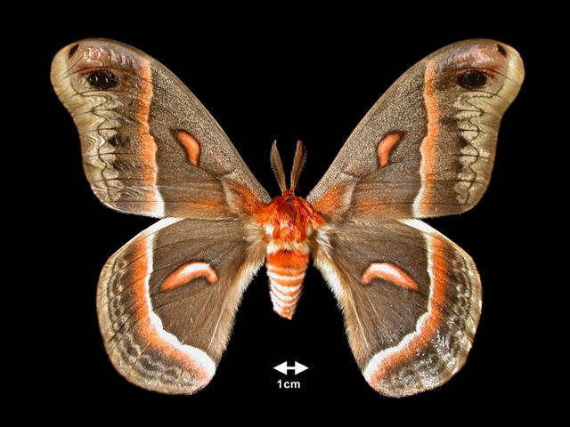
What if we have group variation & study variation driving excessive Heterogeneity?
Moths (Heterocera)
Butterflies (Rhopalocera)

Slide 17
Mixed Effects Model in R
> rma(Hedges.D ~ Suborder, Var.D,
data=lep,
method="DL")

Slide 18
Comparing Fixed v. Mixed
Fixed Model Results:
estimate se zval pval ci.lb ci.ub
intrcpt 0.3875 0.0496 7.8179 <.0001 0.2903 0.4846
SuborderR -0.0540 0.1281 -0.4218 0.6732 -0.3050 0.1970
Mixed Model Results:
estimate se zval pval ci.lb ci.ub
intrcpt 0.3356 0.0777 4.3162 <.0001 0.1832 0.4880
SuborderR 0.0335 0.1723 0.1947 0.8456 -0.3042 0.3713

Slide 19
Solutions to Heterogeneity
Heterogeneity
Allow Variation in θ
Random Effects Model
Model Drivers of Heterogeneity (Fixed)
Model Drivers &
Allow Variation in θ
Mixed Effects Model

Slide 20
Meta-Regression
X is a covariate, can be extended to multiple covariates
T_{i} = θ_{i}+ e_{i}
where
θ_{i =} β₀ + β₁X_{i}
e_{i} ~ N(0,σ_{i}²)

Slide 21
Mixed Model Meta-Regression
T_{i} = θ_{i}+ e_{i}
Where
θ_{i =} β₀ + β₁X_{i}
β₀ ∼ Ν(β_{fixed},τ²)
e_{i} ~ N(0,σ_{i}²)

Slide 22
Additional Considerations for Meta-Regression
Qm is calculated using βs
Q tests as normal
Formula for τ² depends on model structure, and can be quite complex
Can be fixed or mixed effects model

Slide 23
Exploring Polyandry
Is advantage by virgin males is this modified by polyandry within a species?
Agrotis segetum - wikipedia
Torres-Villa and Jennions 2005

Slide 24
Two Least Squares Meta-Regressions
> polyandry_mod <- rma(Hedges.D ~ X..Polyandry, Var.D, data=lep, method="FE")
> polyandry_mod_r <- rma(Hedges.D ~ X..Polyandry, Var.D, data=lep, method="DL")

Slide 25
Fixed Output
Fixed-Effects with Moderators Model (k = 22)
Test for Residual Heterogeneity:
QE(df = 20) = 34.9105, p-val = 0.0206
Test of Moderators (coefficient(s) 2):
QM(df = 1) = 10.2021, p-val = 0.0014
Model Results:
estimate se zval pval ci.lb ci.ub
intrcpt 0.1263 0.0927 1.3635 0.1727 -0.0553 0.3080
X..Polyandry 0.0060 0.0019 3.1941 0.0014 0.0023 0.0097 **
---
Signif. codes: 0 ‘***’ 0.001 ‘**’ 0.01 ‘*’ 0.05 ‘.’ 0.1 ‘ ’ 1

Slide 26
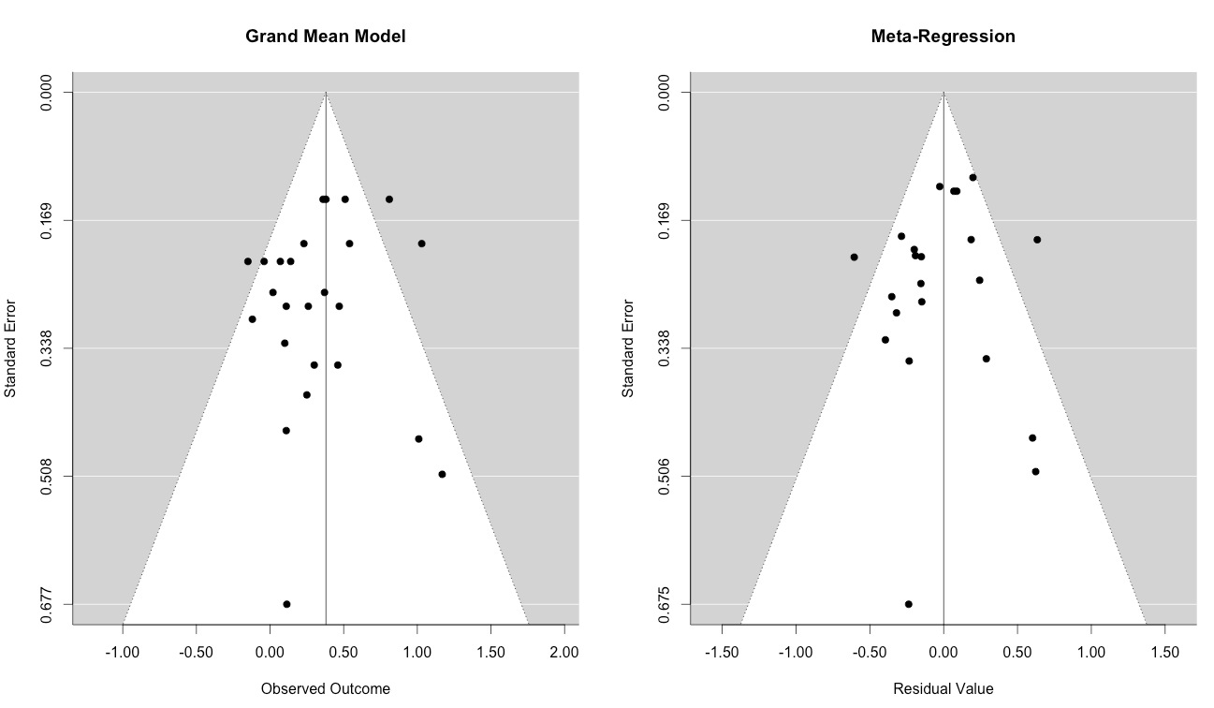
Funnel Plots with Adjusted Values

Slide 27
Mixed Output
Mixed-Effects Model (k = 22; tau^2 estimator: DL)
tau^2 (estimated amount of residual heterogeneity): 0.0381 (SE = 0.0294)
tau (square root of estimated tau^2 value): 0.1951
I^2 (residual heterogeneity / unaccounted variability): 42.71%
H^2 (unaccounted variability / sampling variability): 1.75
R^2 (amount of heterogeneity accounted for): 33.24%
Test for Residual Heterogeneity:
QE(df = 20) = 34.9105, p-val = 0.0206
Test of Moderators (coefficient(s) 2):
QM(df = 1) = 4.3058, p-val = 0.0380

Slide 28
Mixed Output
...
Model Results:
estimate se zval pval ci.lb ci.ub
intrcpt 0.1256 0.1264 0.9934 0.3205 -0.1222 0.3734
X..Polyandry 0.0055 0.0026 2.0750 0.0380 0.0003 0.0107 *
---
Signif. codes: 0 ‘***’ 0.001 ‘**’ 0.01 ‘*’ 0.05 ‘.’ 0.1 ‘ ’ 1

Slide 29
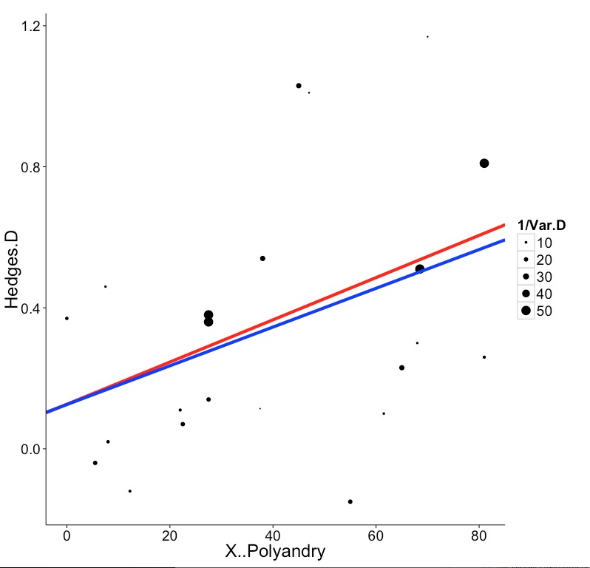
Comparing Fixed and Random Effects

Slide 30
Assumptions!
All of these models still make assumptions
These are least squares linear Gaussian models – same as ANOVA, linear regression, etc.

Slide 31
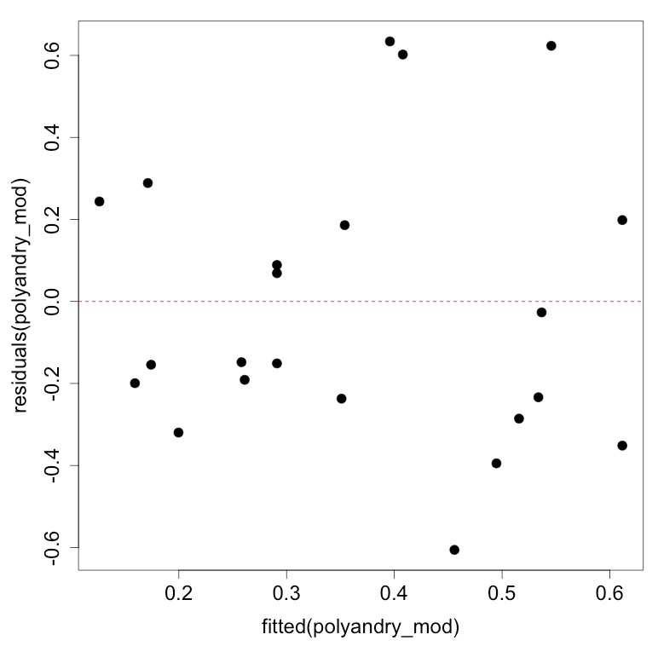
Predicted v. Residuals
Should be no pattern

Slide 32
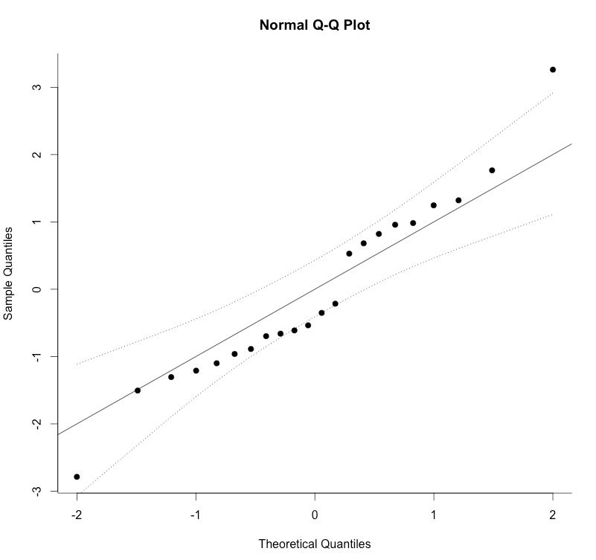
qqnorm(polyandry_mod)

Slide 33
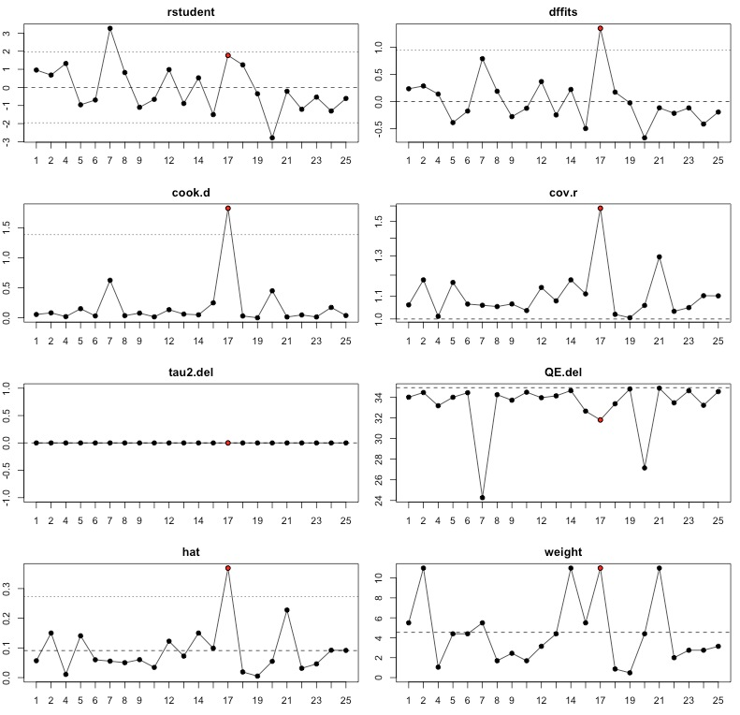
plot(influence(polyandry_mod)

Slide 34
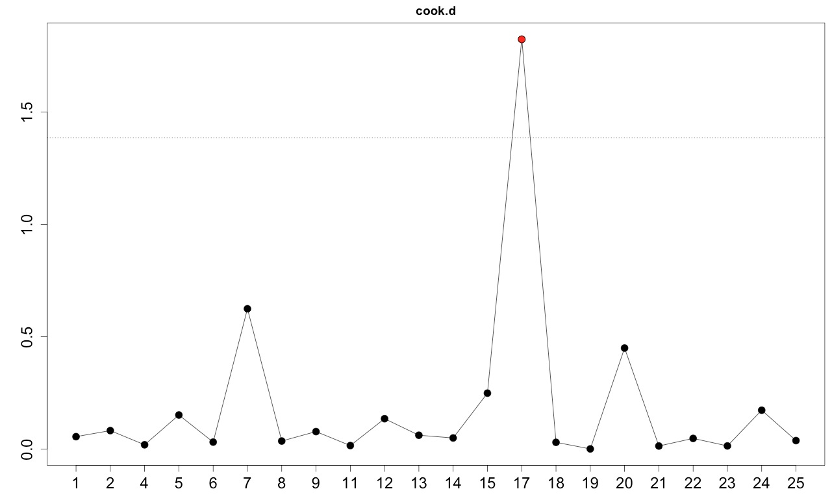
Influence as Measured by Cook’s D

Slide 35
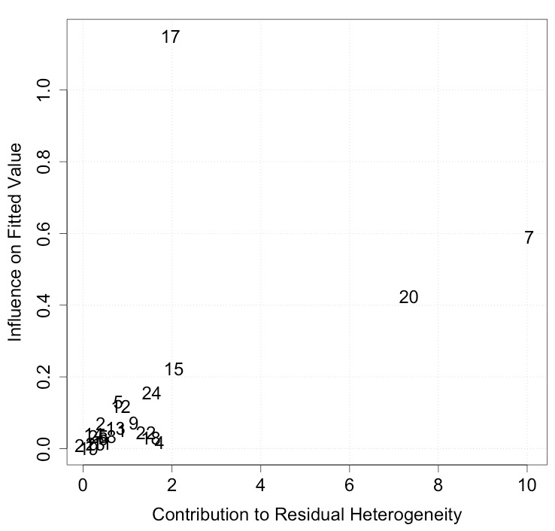
Baujat Plots for Sources of Residual Heterogeneity
> baujat(polyandry_mod)

Slide 36
Exercise
Open load_marine_data.R
Load the marine meta-analysis data
Explore & Share

