Slide 1
Statistical Models in Meta-Analysis
T_{i} ~ N(θ_{i},σ_{i}²)
θ_{i} ~ N(μ,τ²)

Slide 2
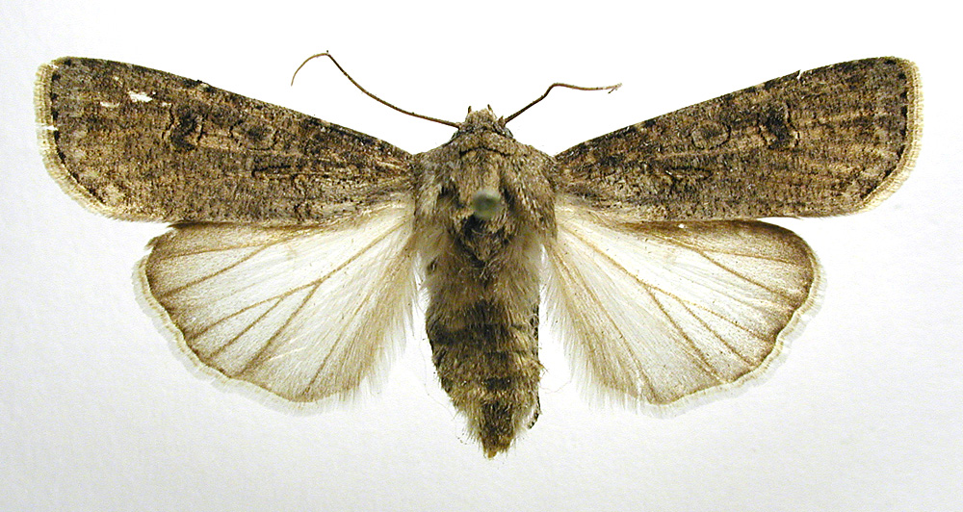
Start with a Question!
Male mating history and female fecundity in the Lepidoptera: do male virgins make better partners?
Agrotis segetum - wikipedia
Torres-Villa and Jennions 2005

Slide 3
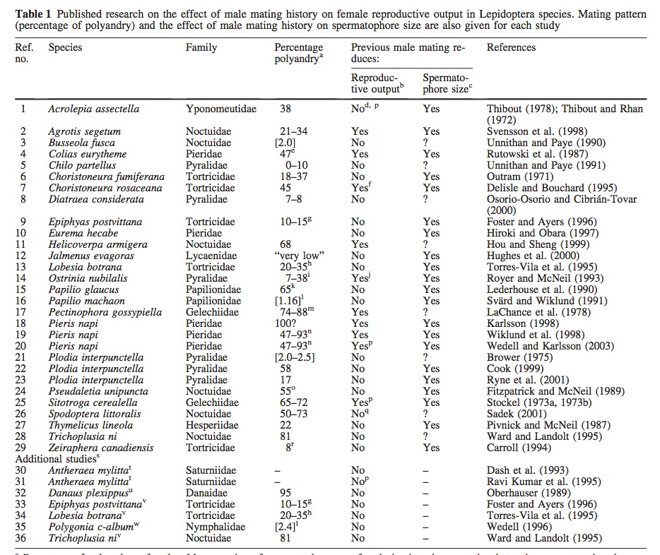

Slide 4
Metric: Compare Virgins v. Experience Males in Number of Eggs Produced
Hedge's D:
D converted from raw data or correlations

Slide 5
Data Visualization: Why?

Slide 6
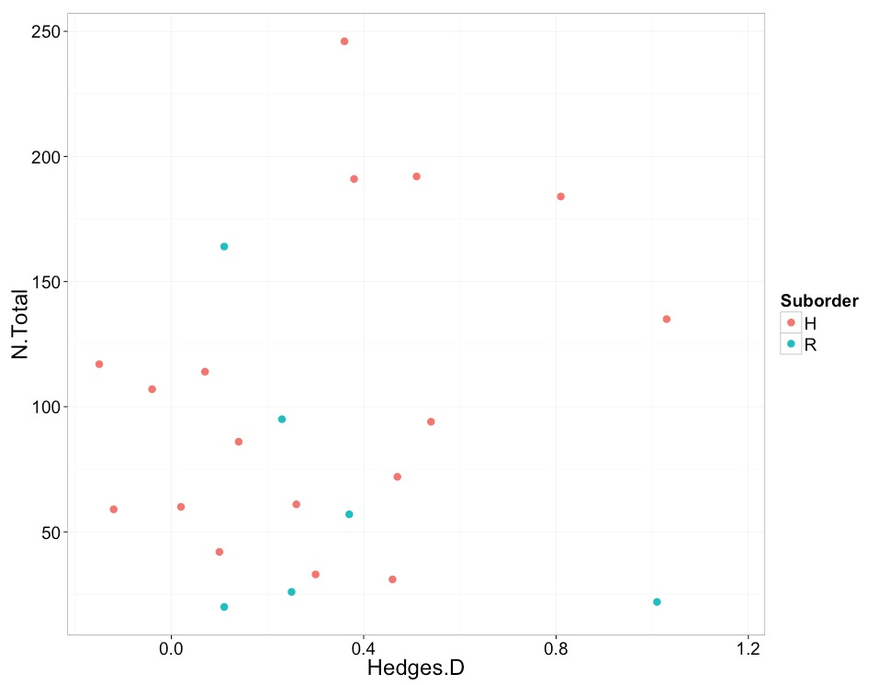
Assumptions: No Effect of Sample Size

Slide 7
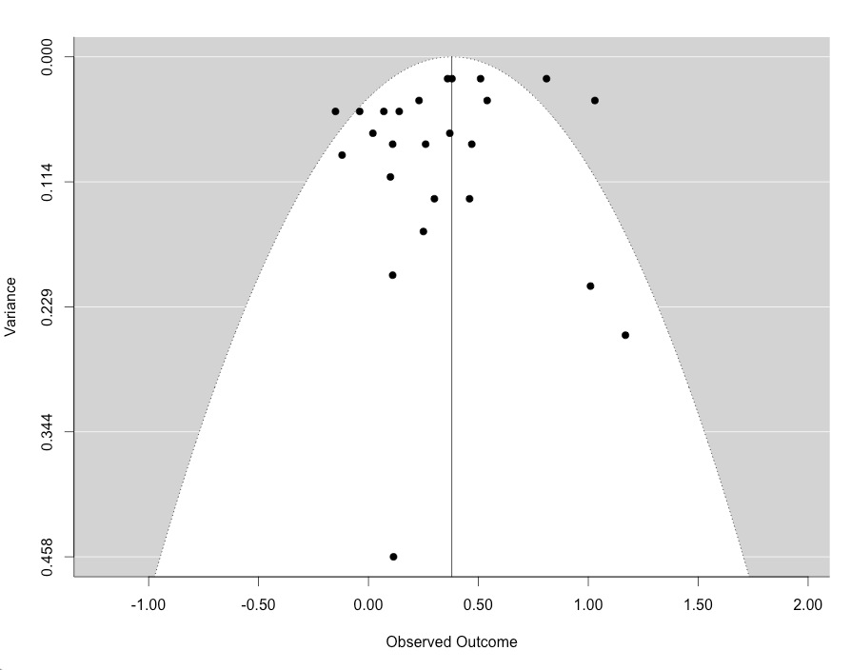
Assumption: No Bias in the Pool of Studies

Slide 8
Visualize the Data: Forest Plot
gm_mod <- rma(Hedges.D, Var.D, data=lep, method="FE")
forest(gm_mod, cex=1.3, slab=lep$Species)
text(6, 27, "Hedge's D [95% CI]", pos=2, cex=1.3)

Slide 9
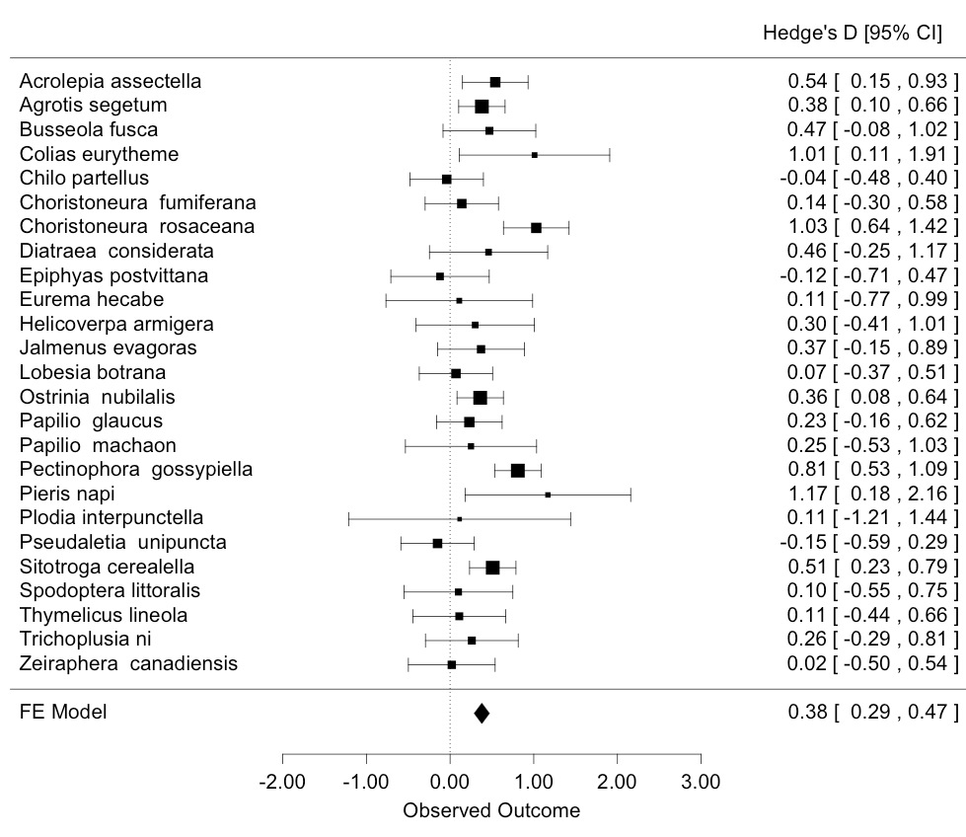

Slide 10
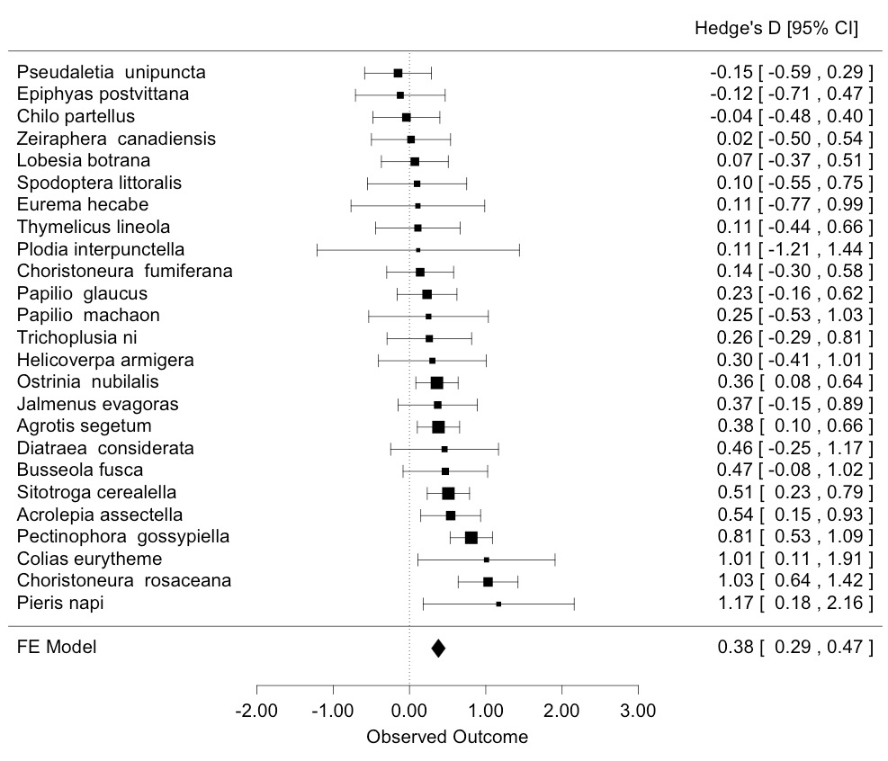
Order by Effect Size (order="obs")

Slide 11
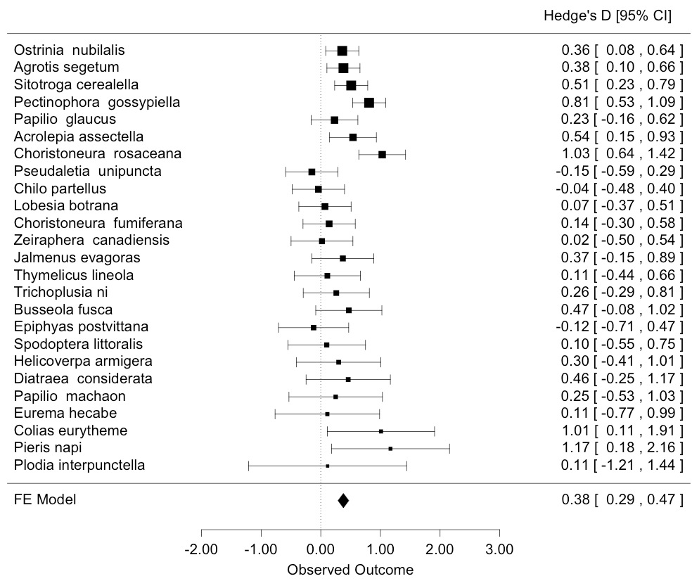
Order by Precision (order="prec")

Slide 12
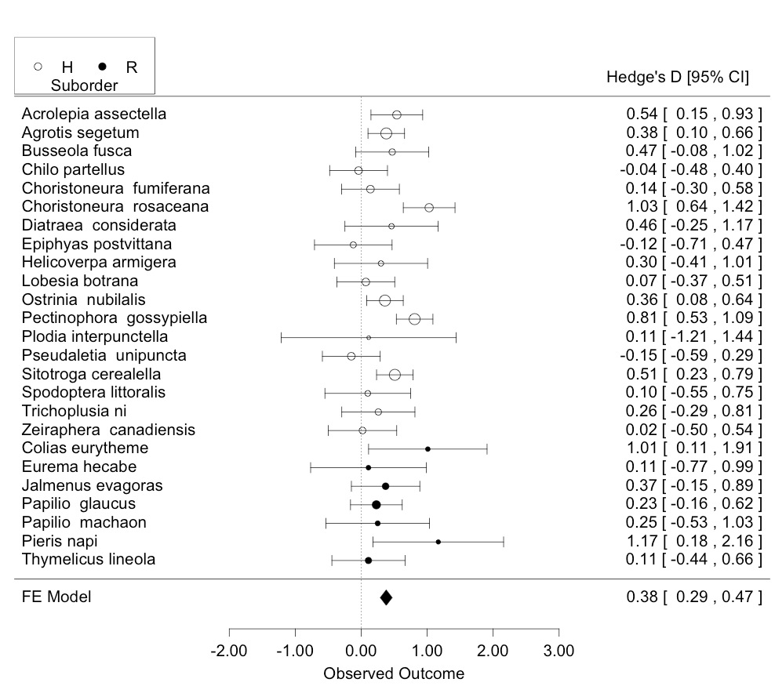
Groupings to Investigate Hypotheses

Slide 13
Data Visualization: Why
See the data!
Find pathological behaviors
Understand influence of studies on results
Evaluate sources of heterogeneity

Slide 14
A First Stab at a Model: Fixed Effects
Starting model: there is only one grand mean, everything else is error
T_{i} = θ_{i} + e_{i}
where
θ_{i} = μ
e_{i} ~ N(0,σ_{i}²)

Slide 15
A First Stab at a Model: Fixed Effects
Starting model: there is only one grand mean, everything else is error
T_{i} ∼ Ν(θ_{i,} σ_{i}²)
where
θ_{i} = μ

Slide 16
There’s a Grand Mean. Everything else is noise.

Slide 17
Meta-Analytic Mean: Estimation
Study Weight:
Grand Mean:
Weighted mean normalized over all weights!
w_{i}/sum(w_{i}) gives you the individual study weight

Slide 18
Is our Effect Different from 0?
Study Weight:
T-test: (μ-μ₀)/s_{μ} with K-1 DF
Variance:
Confidence Interval
μ ± s_{μ} t_{α/2,k-1}

Slide 19
Fitting a Fixed Effect Model in R
> rma(Hedges.D, Var.D, data=lep, method="FE")
Fixed-Effects Model (k = 25)
Test for Heterogeneity:
Q(df = 24) = 45.6850, p-val = 0.0048
Model Results:
estimate se zval pval ci.lb ci.ub
0.3794 0.0457 8.3017 <.0001 0.2898 0.4690

Slide 21
Why is a Grand Mean Not Enough
Maybe there's a different mean for each study, drawn from a distribution of effects?
Maybe other factors lead to additional variation between studies?
Maybe both!
If so, we expect more heterogeneity between studies that a simple residual error would predict.

Slide 22
Assessing Heterogeneity
Q_{t} follows a χ2 distribution with K-1 DF
Test for Heterogeneity:
Q(df = 24) = 45.6850, p-val = 0.0048

Slide 23
How Much Variation is Between Studies?
Percent of heterogeneity due to between study variation
If there is no heterogeneity, I²=0

Slide 24
Solutions to Heterogeneity
Heterogeneity
Allow Variation in θ
Random Effects Model
Model Drivers of Heterogeneity (Fixed)
Model Drivers &
Allow Variation in θ
Mixed Effects Model

Slide 25
The Random Effects Approach
Each study has an effect size, drawn from a distribution
We partition within and between study variation
We can 'borrow' information from each study to help us estimate the effect size for each study

Slide 26
A First Stab at a Model: Fixed Effects
Starting model: there is only one grand mean, everything else is error
T_{i} ∼ Ν(θ_{i,} σ_{i}²)
where
θ_{i} = μ

Slide 27
The Random Effects Model
Each study's mean is drawn from a distribution, everything else is error
T_{i} ∼ Ν(θ_{i}, σ_{i}²)
θ_{i} ∼ Ν(μ,τ²)

Slide 28
The Random Effects Model
Each study's mean is drawn from a distribution, everything else is error
T_{i} = θ_{i} + e_{i}
where
θ_{i} ∼ N(μ,τ²)
e_{i} ~ N(0, σ_{i}²)

Slide 29
There is a Grand Mean Study Means are from a distribution Also, there’s additional error…

Slide 30
What is Different?
Fixed Effect Study Weight:
Random Effect Study Weight:
Estimate μ and σ²_{μ} in exactly the same way as before!

Slide 31
What is τ²?
Different approximations
We will use the DerSimonian & Laird's method
Varies with model structure
Can be biased! (use ML)

Slide 32
What is τ²?
Q_{t}, w_{i}, etc. are all from the fixed model
This formula varies with model structure

Slide 33
Fitting a Random Effect Model in R
> rma(Hedges.D, Var.D, data=lep, method="DL")
Random-Effects Model (k = 25; tau^2 estimator: DL)
tau^2 (estimated amount of total heterogeneity): 0.0484 (SE = 0.0313)
tau (square root of estimated tau^2 value): 0.2200
I^2 (total heterogeneity / total variability): 47.47%
H^2 (total variability / sampling variability): 1.90
Test for Heterogeneity:
Q(df = 24) = 45.6850, p-val = 0.0048
Model Results:
estimate se zval pval ci.lb ci.ub
0.3433 0.0680 5.0459 <.0001 0.2100 0.4767

Slide 34
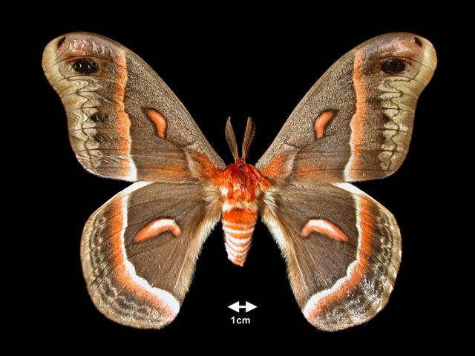
What if we have a group variation drives excessive Heterogeneity?
Moths (Heterocera)
Butterflies (Rhopalocera)

Slide 35
A Fixed Effect Group Model
Starting model: there are group means, everything else is error
T_{i} ∼ Ν(θ_{im,} σ_{i}²)
where
θ_{im} = μ_{m}

Slide 36
Estimation of Fixed Effect Models with Groups
Just add group structure to what we have already done

Slide 37
Estimation of Fixed Effect Models with Groups
Study Weight:
Weighted mean normalized over all weights in group m!
Group Mean:
Group Variance:

Slide 38
So…Does Group Structure Matter?
Qt = Qm + Qe
We can now partition total variation into that driven by the model versus residual heterogeneity
Kinda like ANOVA, no?

Slide 39
Within Group Residual Heterogeneity
Just the sum of the residuals from a group means
K_{m}-1 Degrees of Freedom where Km is the sample size within a group
Tells you whether there is excessive residual heterogeneity within a group

Slide 40
Total Residual Heterogeneity
Just the sum of the residuals from the group means
n - M Degrees of Freedom
Is there still excessive heterogeneity in the data?

Slide 41
Modeled Heterogeneity
Just the sum of the residuals from the group means
W_{m} = sum of group weights
M-1 Degrees of Freedom for a χ2 test
Does our model explain some heterogeneity?

Slide 42
Put it to the Test!
> rma(Hedges.D ~ Suborder, Var.D, data=lep, method="FE")
Fixed-Effects with Moderators Model (k = 25)
Test for Residual Heterogeneity:
QE(df = 23) = 45.5071, p-val = 0.0034
Test of Moderators (coefficient(s) 2):
QM(df = 1) = 0.1779, p-val = 0.6732

Slide 43
Put it to the Test!
> rma(Hedges.D ~ Suborder, Var.D, data=lep, method="FE")
...
Model Results:
estimate se zval pval ci.lb ci.ub
intrcpt 0.3875 0.0496 7.8179 <.0001 0.2903 0.4846 SuborderR -0.0540 0.1281 -0.4218 0.6732 -0.3050 0.1970

Slide 44
