Slide 1
I like Bayesian inference…how do I use it?

Slide 2
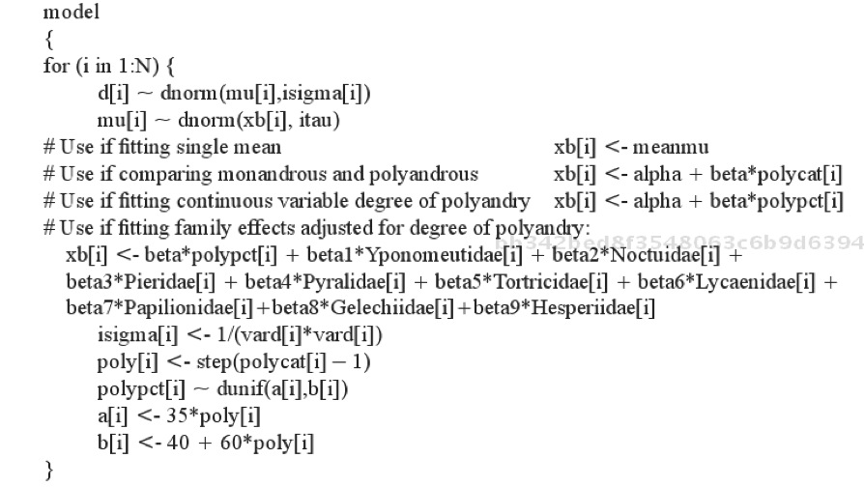

Slide 3
BUGS links Model & Code
model{
for(i in 1:N){
isigma[i] <- 1/sigma[i]
d[i] ~ dnorm(theta[i], isigma[i])
theta[i] ~ dnorm(mu, itau)
}
#priors
mu ~ dnorm(0, 1e-06)
tau ~ dunif(0,1000)
itau <- 1/tau
}

Slide 4
Hierarchical Model in BUGS
model{
for(i in 1:N){
isigma[i] <- 1/sigma[i]
d[i] ~ dnorm(phi[i], isigma[i])
phi[i] ~ dnorm(theta[Study[i]], iomega[Study[i]])
}
for(j in 1:K){
theta[j] ~ dnorm(mu, itau)
}
#priors
mu ~ dnorm(0, 1e-06)
tau ~ dunif(0,1000)
itau <- 1/tau
}

Slide 5
Whoah! What about R?

Slide 6
MCMCglmm
MCMCglmm library
coda library for looking at MCMC chains

Slide 7
The basic MCMCglmm
marine_mcmc <-
MCMCglmm(LR ~ 1,
random = ~ Study,
mev= marine$VLR,
data=marine)

Slide 8
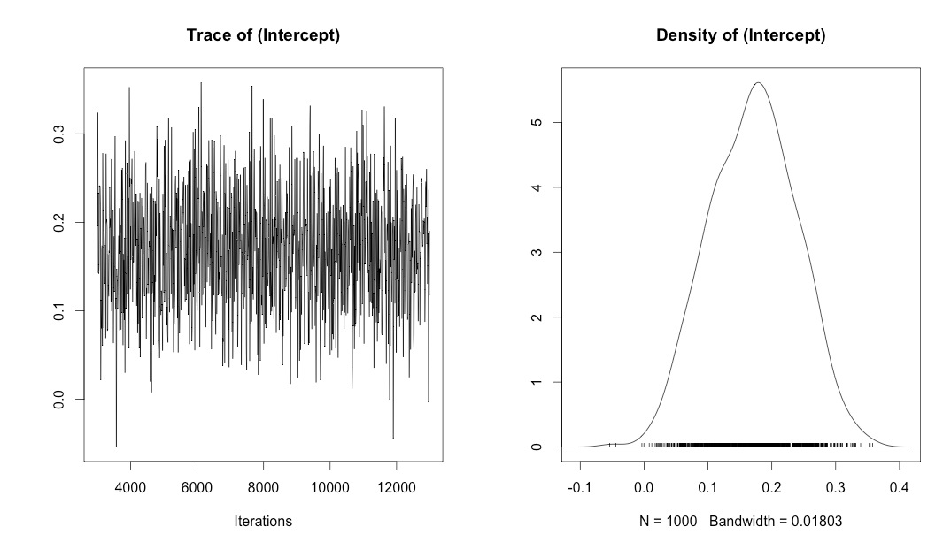
Chain of Intercepts… (from plot)

Slide 9
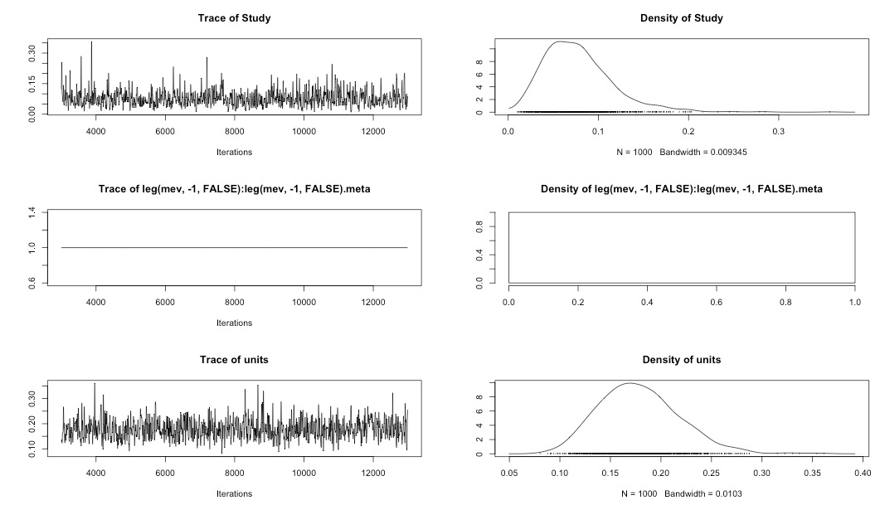
Variance Components

Slide 10
Priors…
Specify Priors in separate list
Flat prior
prior<-list(B=list(mu=c(0),V=diag(c(1e+10))))
Informative prior
prior<-list(B=list(mu=c(1),V=diag(c(2))))

Slide 11
Summary with Credible Intervals
Iterations = 3001:12991
Thinning interval = 10
Sample size = 1000
DIC: 203.4118
G-structure: ~Study
post.mean l-95% CI u-95% CI eff.samp
Study 0.07771 0.0101 0.1487 783.3
R-structure: ~units
post.mean l-95% CI u-95% CI eff.samp
units 0.1786 0.1083 0.2581 872.8
Location effects: LR ~ 1
post.mean l-95% CI u-95% CI eff.samp pMCMC
(Intercept) 0.17066 0.04011 0.29359 1000 0.008 **
---
Signif. codes: 0 ‘***’ 0.001 ‘**’ 0.01 ‘*’ 0.05 ‘.’ 0.1 ‘ ’ 1

Slide 12
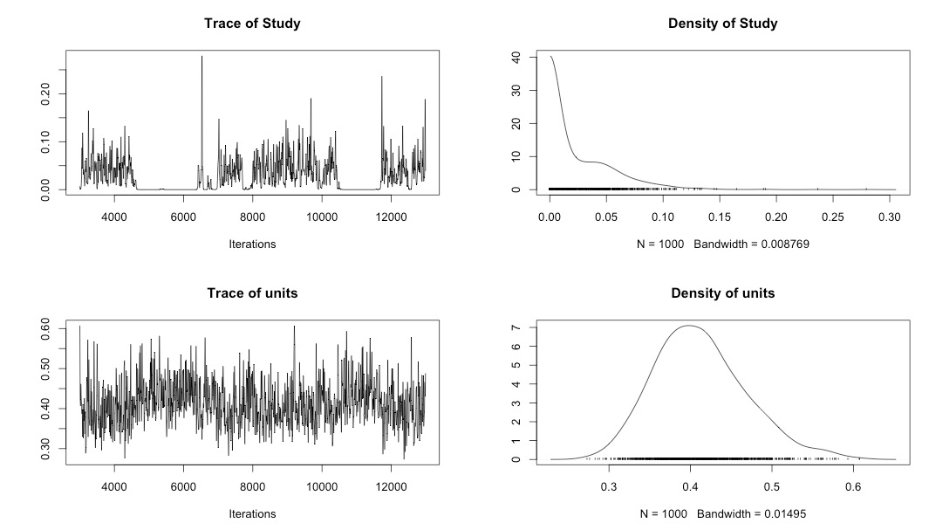
What a Bad Chain Looks Likes (no study variances included)

Slide 13
Multiple Chains to Diagnose Convergence
marine_mcmc_1 <- MCMCglmm(LR ~ 1, random = ~ Study, mev= marine$VLR, data=marine)
marine_mcmc_2 <- MCMCglmm(LR ~ 1, random = ~ Study, mev= marine$VLR, data=marine)
marine_mcmc_3 <- MCMCglmm(LR ~ 1, random = ~ Study, mev= marine$VLR, data=marine)

Slide 14
Multiple Chains to Diagnose Convergence
chainList <- mcmc.list(marine_mcmc_1$Sol, marine_mcmc_2$Sol, marine_mcmc_3$Sol)
chainList_vcv <- mcmc.list(marine_mcmc_1$VCV[,-2], marine_mcmc_2$VCV[,-2], marine_mcmc_3$VCV[,-2])

Slide 15
Gelman-Rubin Diagnostics
> gelman.diag(chainList)
Potential scale reduction factors:
Point est. Upper C.I.
(Intercept) 1 1
> gelman.diag(chainList_vcv)
Potential scale reduction factors:
Point est. Upper C.I.
Study 1 1.01
units 1 1.01
Multivariate psrf
1.01

Slide 16
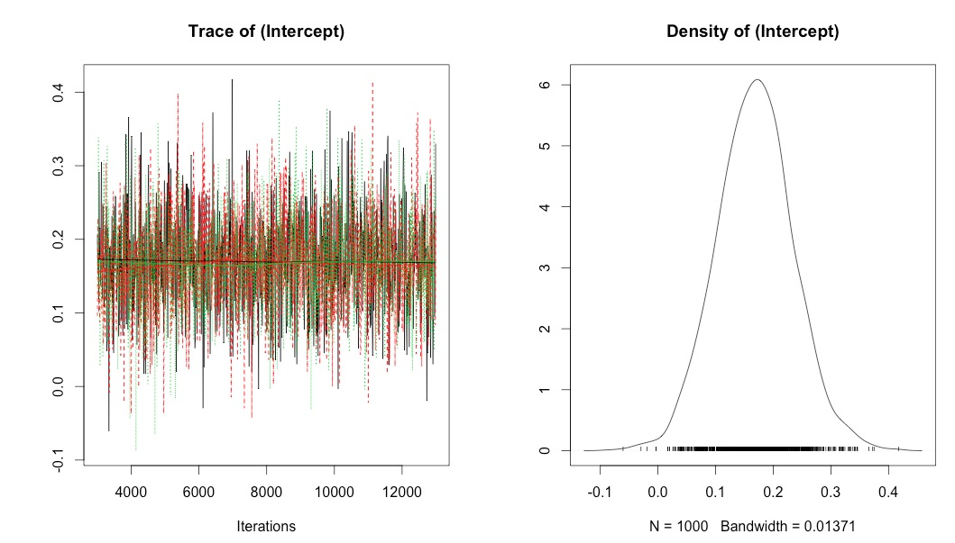
Plotting Chains Shows Convergence

Slide 17
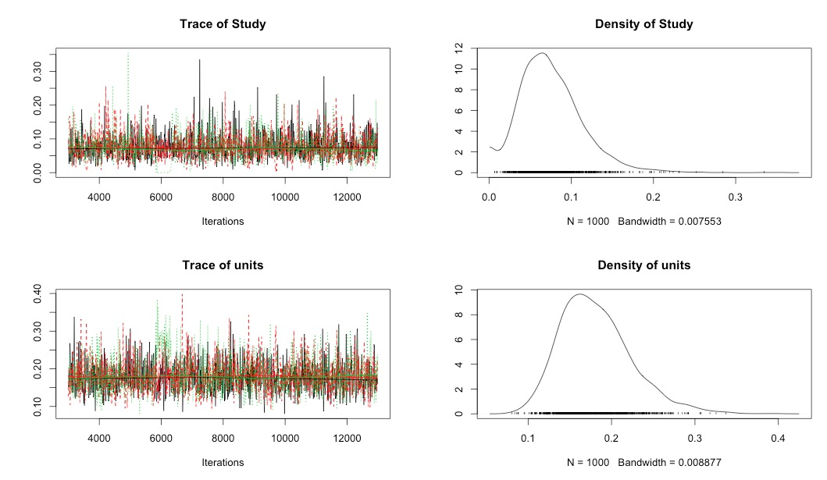
Plotting Chains Shows Convergence

