Slide 1


Power in meta-analysis

Slide 2
Objectives
What is power?
What determines the statistical power of meta-analysis?
What are the statistics for calculating power of pooled effect sizes?
What are the statistics for calculating power of within- and between-study homogeneity tests?
How can I improve my statistical power?
How many pictures of the worlds most powerful man can I put in this lecture?

Slide 3
What is power?
On Buzzfeed’s Top 5 reasons to do a metaanalysis
  Increased power over individual studies
Probability of finding a significant result when it exists

Slide 4

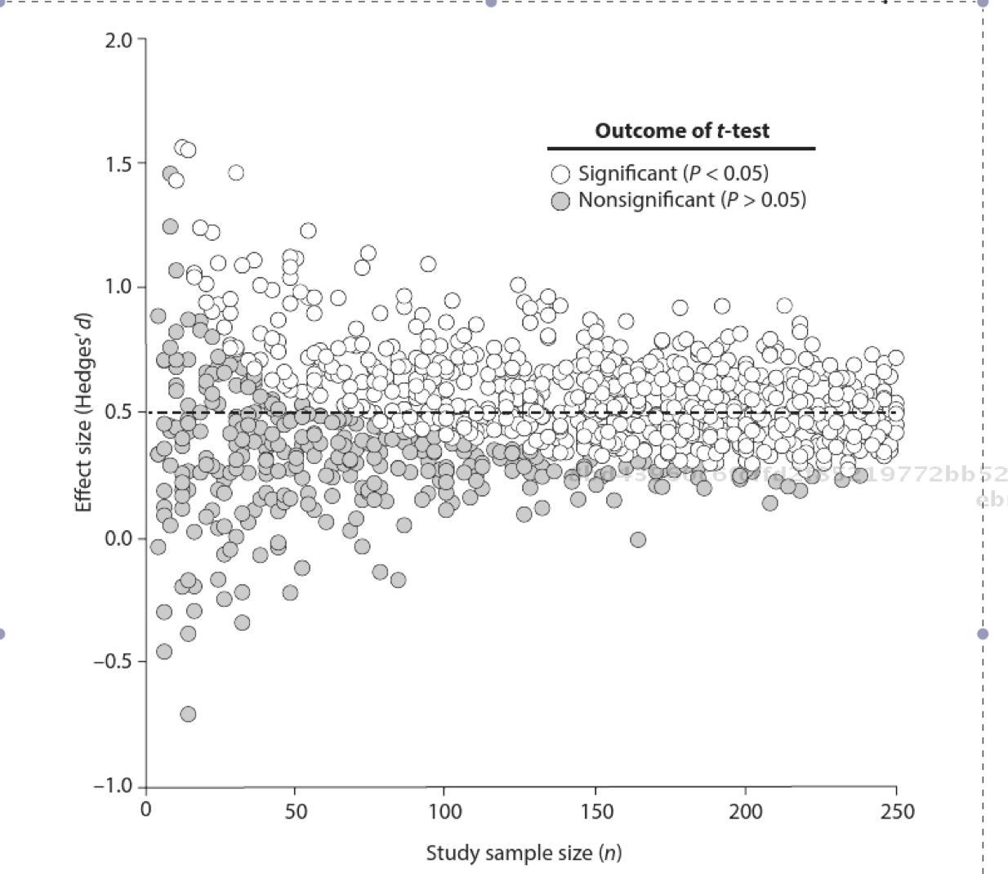
What determines the statistical power in an experiment?

Slide 5
What determines the statistical power of metaanalysis?
Power of pooled effect sizes

Slide 6

What determines the statistical power of metaanalysis?
Power increases when:
Large non-zero effect sizes
Lenient significance levels
Many studies included in review
BUT if there is large sampling error within study, power decreases

Slide 7

Retrospective power analysis
Hard retrospective power analysis
  Observed effect size used
  Null studies will always have low power
Soft retrospective power analysis
  Use hypothesized effect sizes
    0.2, 0.5, 0.8, or info from the literature

Slide 8

When is there enough power?

Slide 9
What are the statistics for calculating power of pooled effect sizes?
Power stats for mean effect sizes (soft retrospective)

Slide 10
What are the statistics for calculating power of pooled effect sizes?
Confidence Intervals

Slide 11

What are the statistics for calculating power of homogeneity tests?
Fixed effects
  Within study homogeneity

Slide 12
What are the statistics for calculating power of homogeneity tests?
Fixed effects with moderators
  Between study homogeneity

Slide 13
What are the statistics for calculating power of homogeneity tests?
Random effects with moderators
  Between study homogeneity

Slide 14
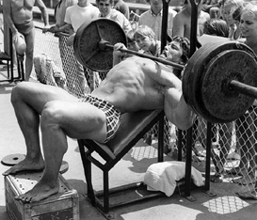
How do we become more powerful?
Collate more studies
  Lower variance, CI width
Be specific with experimental outcome of interest
  Pick measurements closely aligned with biological effect of interest
Use a more precise effect size
  Better estimates population effect, but don’t be too stringent!
Transform effect size into a better metric
  Like Fisher’s z

Slide 15
How do we become more powerful?
Use effect size variance that requires more info from study
  Weight efficiency increased but often difficult
Account for/avoid nonindependence of effect sizes
  Must know how effect sizes are correlated, which is rare
Exclude outliers
  Decreases deviation and improves heterogeneity evaluation
Impute missing data
  You know what they say about assuming…
Use moderator groupings or covariates to explain vatation among research outcomes
  Removes a lot of noise but also addition of parameters is never a great thing

Slide 16

POWER
In meta-analyses confidence intervals are most commonly used
May be more useful in heterogeneity detection
Also can use prospective to see when to stop adding studies to the MA

