Slide 1
Bayesian Inference!!!
Jillian Dunic and Alexa R. Wilson
Notes:
Nice statement from http://astronomy.swin.edu.au/~cblake/StatsLecture4.pdf
Philosophy of science : we do not “rule out” models, just determine their relative probabilities

Slide 2
Step One: Select your model (fixed, random, mixed)
Step Two: What’s your distribution?
Step Three: What approach will you use to estimate your parameters?
ASK:
Are your true values known?
Is your model relatively “complicated”?
No
Yes
Moment Based & Least Squares
Likelihood
Bayesian
*gives approximation
*both methods giving true estimates
Notes:
Might need to explain what ‘true’ estimates are.

Slide 3
Frequentist vs. Bayes
Data are random
Parameters are unknown constants
P(data|parameter)
No prior information
In a vacuum
Data are fixed
Parameters are random variables
P(parameters|data)
Uses prior information
Not in a vacuum
Notes:
FREQUENTIST IS MM, LS, and LL!!!!!!
--Frequentist is what is most commonly used, most of what you have learned, what you are familiar with
--probability of data given the model parameters
--It’s like you are looking at the data in a vacuum; you are looking at one study in your analysis; you ignore any prior information
--There is no incorporation of prior information...that is typically incorporated once you get to the discussion section of your paper

Slide 4
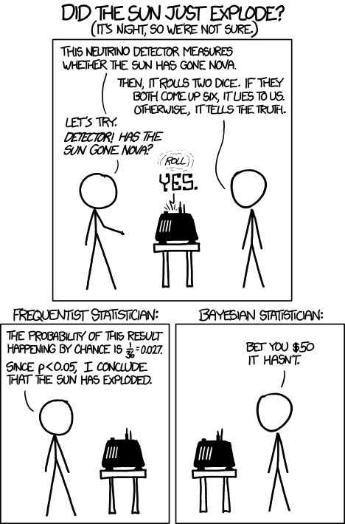
So what is Bayes?
http://imgs.xkcd.com/comics/frequentists_vs_bayesians.png

Slide 5
So what is Bayes?
Bayes Theorem:
http://imgs.xkcd.com/comics/frequentists_vs_bayesians.png
Notes:
The p(data) on the bottom is just a correction factor so the probabilities equal to 1

Slide 6
So what is Bayes?
Bayes Theorem:
Likelihood
Prior
http://imgs.xkcd.com/comics/frequentists_vs_bayesians.png
Notes:
The p(data) on the bottom is just a correction factor so the probabilities equal to 1

Slide 7
Bayes
Bayes is likelihood WITH prior information
Prior + Likelihood = Posterior
(existing data) + (frequentist likelihood) = output
Empirical Bayes: when like the frequentist approach, you assume S² = σ² ...whether you do this depends on the sample size
Notes:
with Bayes you can actually get estimates for these

Slide 8
Choosing Priors
Choose well, it will influence your results…
CONJUGATE: using a complimentary distribution
PRIOR INFORMATION: data from literature, pilot studies, prior meta-analyses, etc.
UNINFORMATIVE: weak, but can be used to impose constraints and good if you have no information
Notes:
Conjugate is obsolete….it was used more in the days prior to this sort of computational capacity. It is basically taking your data with whatever distribution and your prior, which is complimentary distribution, and spitting out a posterior that is analytically feasible.

Slide 9
Uninformative Priors
Mean: Normal distribution (-∞, ∞)
Standard deviation: Uniform distribution (0, ∞)
Notes:
Reminder that variances cannot be negative (squared values)

Slide 10
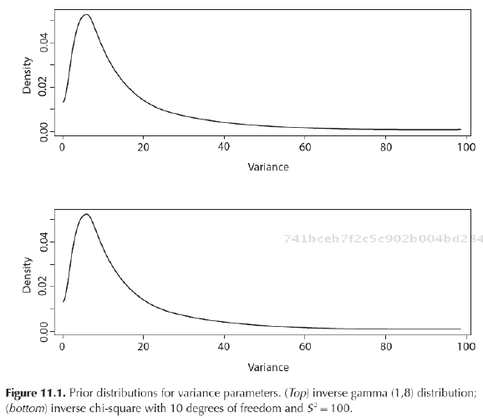
Example of uninformative variance priors
Inverse gamma distribution
Inverse chi-square distribution

Slide 11
Priors and Precision
The influence of your priors and your likelihood in the posterior depends on their variance; lower variance, greater weight (and vice versa)
Prior
Likelihood
Posterior
Notes:
**precision is weighted based on variance…. more precise, better weight in posterior
**the influence of priors decreases with sample size and whether it is strong or weak

Slide 12
So why use Bayes over likelihood?
If using uninformative priors, results are ~LL
Bayes can treat missing data as a parameter
Better for tricky, less common distributions
Complex data structures (e.g., hierarchical)
If you want to include priors
Notes:
Bayes – with multiple parameters, uncommon data distributions and missing data
And when true values aren’t known (unlike in moment based)
Explicit statement of current state of knowledge

Slide 13

More Lepidoptera!
Notes:
Bayes – with multiple parameters, uncommon data distributions and missing data
And when true values aren’t known (unlike in moment based)
Explicit statement of current state of knowledge

Slide 14
T_{i}

Slide 15
T_{i}

Slide 16
T_{i}
Notes:
We don’t know theta i, each study’s mean, but what we do know is that it is normally distributed around mean mu, with variance tau-squared.

Slide 17
T_{i}
Notes:
We don’t know theta i, each study’s mean, but what we do know is that it is normally distributed around mean mu, with variance tau-squared.

Slide 18
T_{i}
Notes:
We don’t know theta i, each study’s mean, but what we do know is that it is normally distributed around mean mu, with variance tau-squared.

Slide 19
T_{i}
Notes:
We don’t know theta i, each study’s mean, but what we do know is that it is normally distributed around mean mu, with variance tau-squared.

Slide 20
Choosing priors
No prior information → use uninformative priors
Uninformative priors:
  Means → normal
  Standard Deviation → uniform

Slide 21
Prior for mean µ

Slide 22
Prior for variance: τ²

Slide 23
MCMC general process
Samples the posterior distribution you’ve generated (prior + likelihood)
Select starting value (e.g., 0, educated guess at parameter values, or moment based/least squares values)
Algorithm structures search through parameter space (tries combinations of parameters simultaneously if multivariate model)
Output is a posterior probability distribution
Notes:
I’m not sure this is right about the peak is where the best parameter estimates are? Feel free to redo this slide. ←I think you are right, but if not, you are close and this makes perfect sense.
MCMC is part of what helps us deal with complicated data structures.
As we said we often use Bayes when we’re dealing with complicated data structures or missing data. Often we cannot produce analytical solutions to be like boom, here’s our posterior distribution. So it exists, we just don’t know what it looks like until we sample over it. It’s more complicated than this but at the most simple level it takes a set of parameter values and says okay, what is the probability of this happening and depending on some more math, it will be like okay, so the probability of these is X and then move on to sample another part of the distribution so that bit by bit, we build up what our posterior looks like.

Slide 24
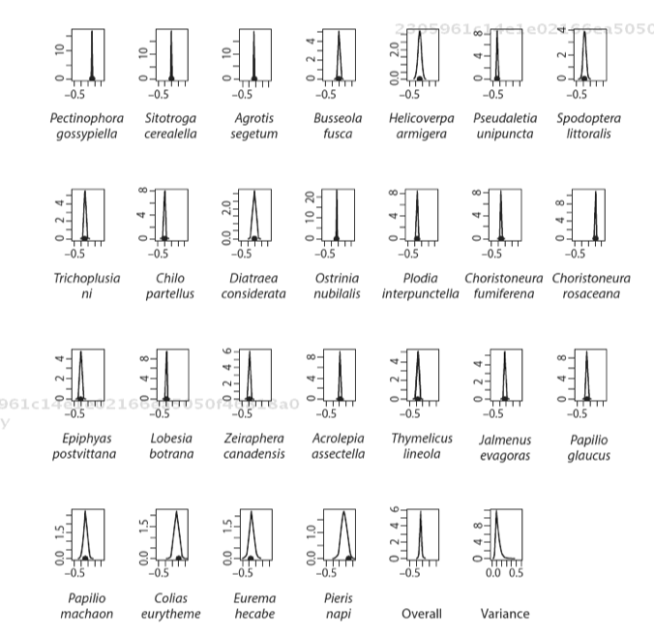
S_{i}² = 0.02
Notes:
So each of these is the outcome of 10000 sampling events of the posterior distributions for each.
Here are the posterior probabilities for each of the species in the analysis. The solid black dots are the measured effect sizes for each species (Hedge’s D). We can see that when estimates were very precise, and the within study variances were small, like Pectinophora gossypiella, the

Slide 25
S_{i}² = 0.02
S_{i}² = 0.26
Notes:
Here are the posterior probabilities for each of the species in the analysis. The solid black dots are the measured effect sizes for each species (Hedge’s D). We can see that when estimates were very precise, and the within study variances were small, like Pectinophora gossypiella. But when variances are big, there is shrinkage (what is shrinkage again?) where the estimate of the mean for this sample is still close to 0.33 even though the measured value was smaller.

Slide 26
Grand mean conclusions
Overall mean effect size = 0.32
Posterior probability of positive effect size is 1, so we are almost certain the effect is positive.
Notes:
Do we calculate the posterior probability of positive effect size by integrating over mu > 0 on our grand mean posterior distribution?
Out of 10 000 runs all 10 000 estimates had a positive effect size, and because our posterior probability always had a positive effect size, we can say that we are almost certain that the effect is positive.
**Also, in Bayes interpretation, that is like saying: “There is a 100% probability that the effect size is postiive”

Slide 27
Example 2 – Missing Data!
Want to include polyandry as fixed effect
BUT missing data from 3 species
Bayes to the rescue!
Notes:
If we were using likelihood we would have to exclude these three studies. But we have to be careful to exclude these data because there might be a reason for the absence of the data and it being missing might not be random so we could risk biasing our results. It also means that we reduce the power of our analysis.

Slide 28
What we know
Busseola fusca = monandrous
Papilio machaon = polyandrous
Eurema hecabe = polyandrous
Monandry < 40% multiple mates
Polyandry > 40% multiple mates
Notes:
If we were using likelihood we would have to exclude these three studies. But we have to be careful to exclude these data because there might be a reason for the absence of the data and it being missing might not be random so we could risk biasing our results. It also means that we reduce the power of our analysis.
And while we do not know the extent to which these species are polyandrous or monandrous, we do know that Busseola fusca is monandrous while Papilio machaon and Eurema hecabe are both polyandrous.

Slide 29
So what do we do?
Let’s estimate the values for the missing percentages!
Set different, and relatively uninformative priors for monandrous and polyandrous species
Notes:
If we were using likelihood we would have to exclude these three studies. But we have to be careful to exclude these data because there might be a reason for the absence of the data and it being missing might not be random so we could risk biasing our results. It also means that we reduce the power of our analysis.
And while we do not know the extent to which these species are polyandrous or monandrous, we do know that Busseola fusca is monandrous while Papilio machaon and Eurema hecabe are both polyandrous.

Slide 30
Prior for X_{M}

Slide 31
Prior for X_{P}

Slide 32
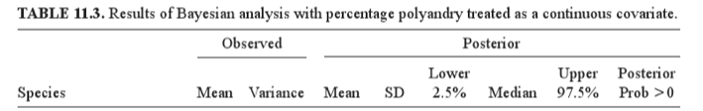

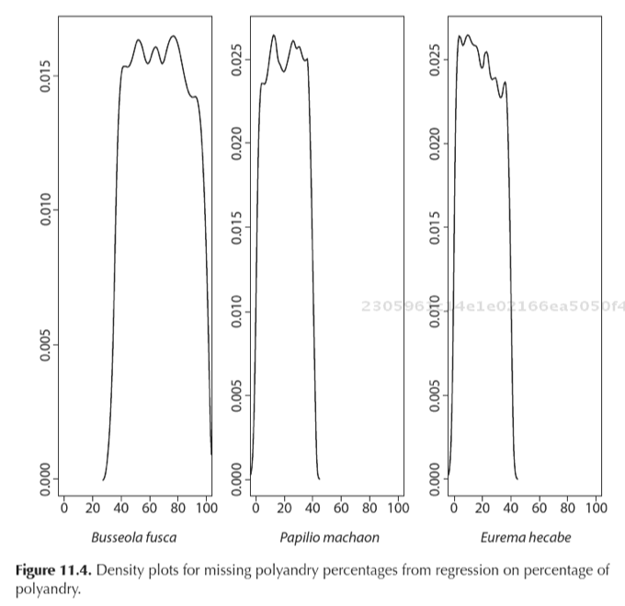

Slide 33
Final Notes & Re-Cap
At the end of the day, it is really just another method to achieve a similar goal, the major difference is that you are using likelihood AND priors
REMEMBER: Bayes is a great tool in the toolbox for when you are dealing with:
  Missing data
  Abnormal distributions
  Complex data structures
  Or have/want to include prior information
Notes:
There are unique diagnostics and some differences in interpreting results

